Slide 1
FLOWCHART & APPLICATION WORKFLOW

Slide 2
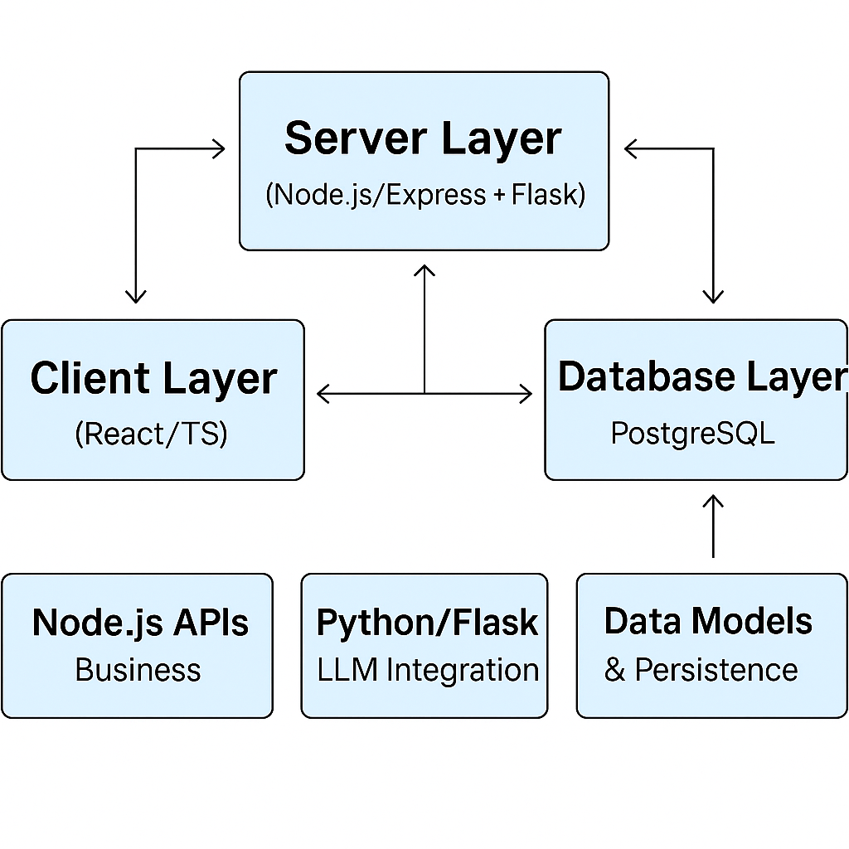
APPLICATION WORKFLOW

Slide 3
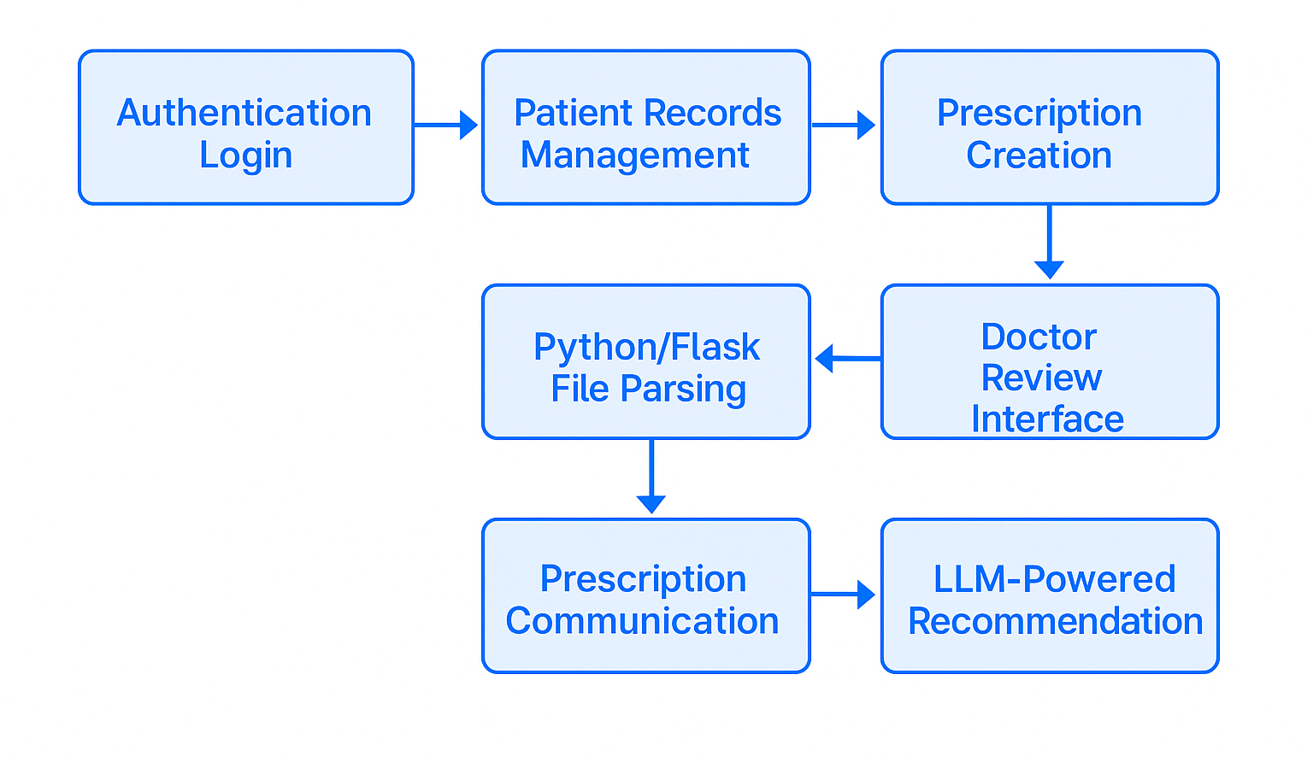
FLOWCHART

Slide 4
